Slide 1
Differential Privacy and the 2020 Census in the United States
John M. Abowd Chief Scientist and Associate Director for Research and Methodology U.S. Census Bureau
IPS 161 Formal privacy methods in NSO: Challenges and Solutions World Statistics Congress July 16, 2021, 9:00am-10:30am (EDT USA)
The views expressed in this talk are my own and not those of the U.S. Census Bureau. DRB Clearance number CBDRB-FY20-DSEP-001.

Slide 2
Going from suppression to differential privacy is much easier than going from publishing all the microdata to differential privacy.

Slide 3
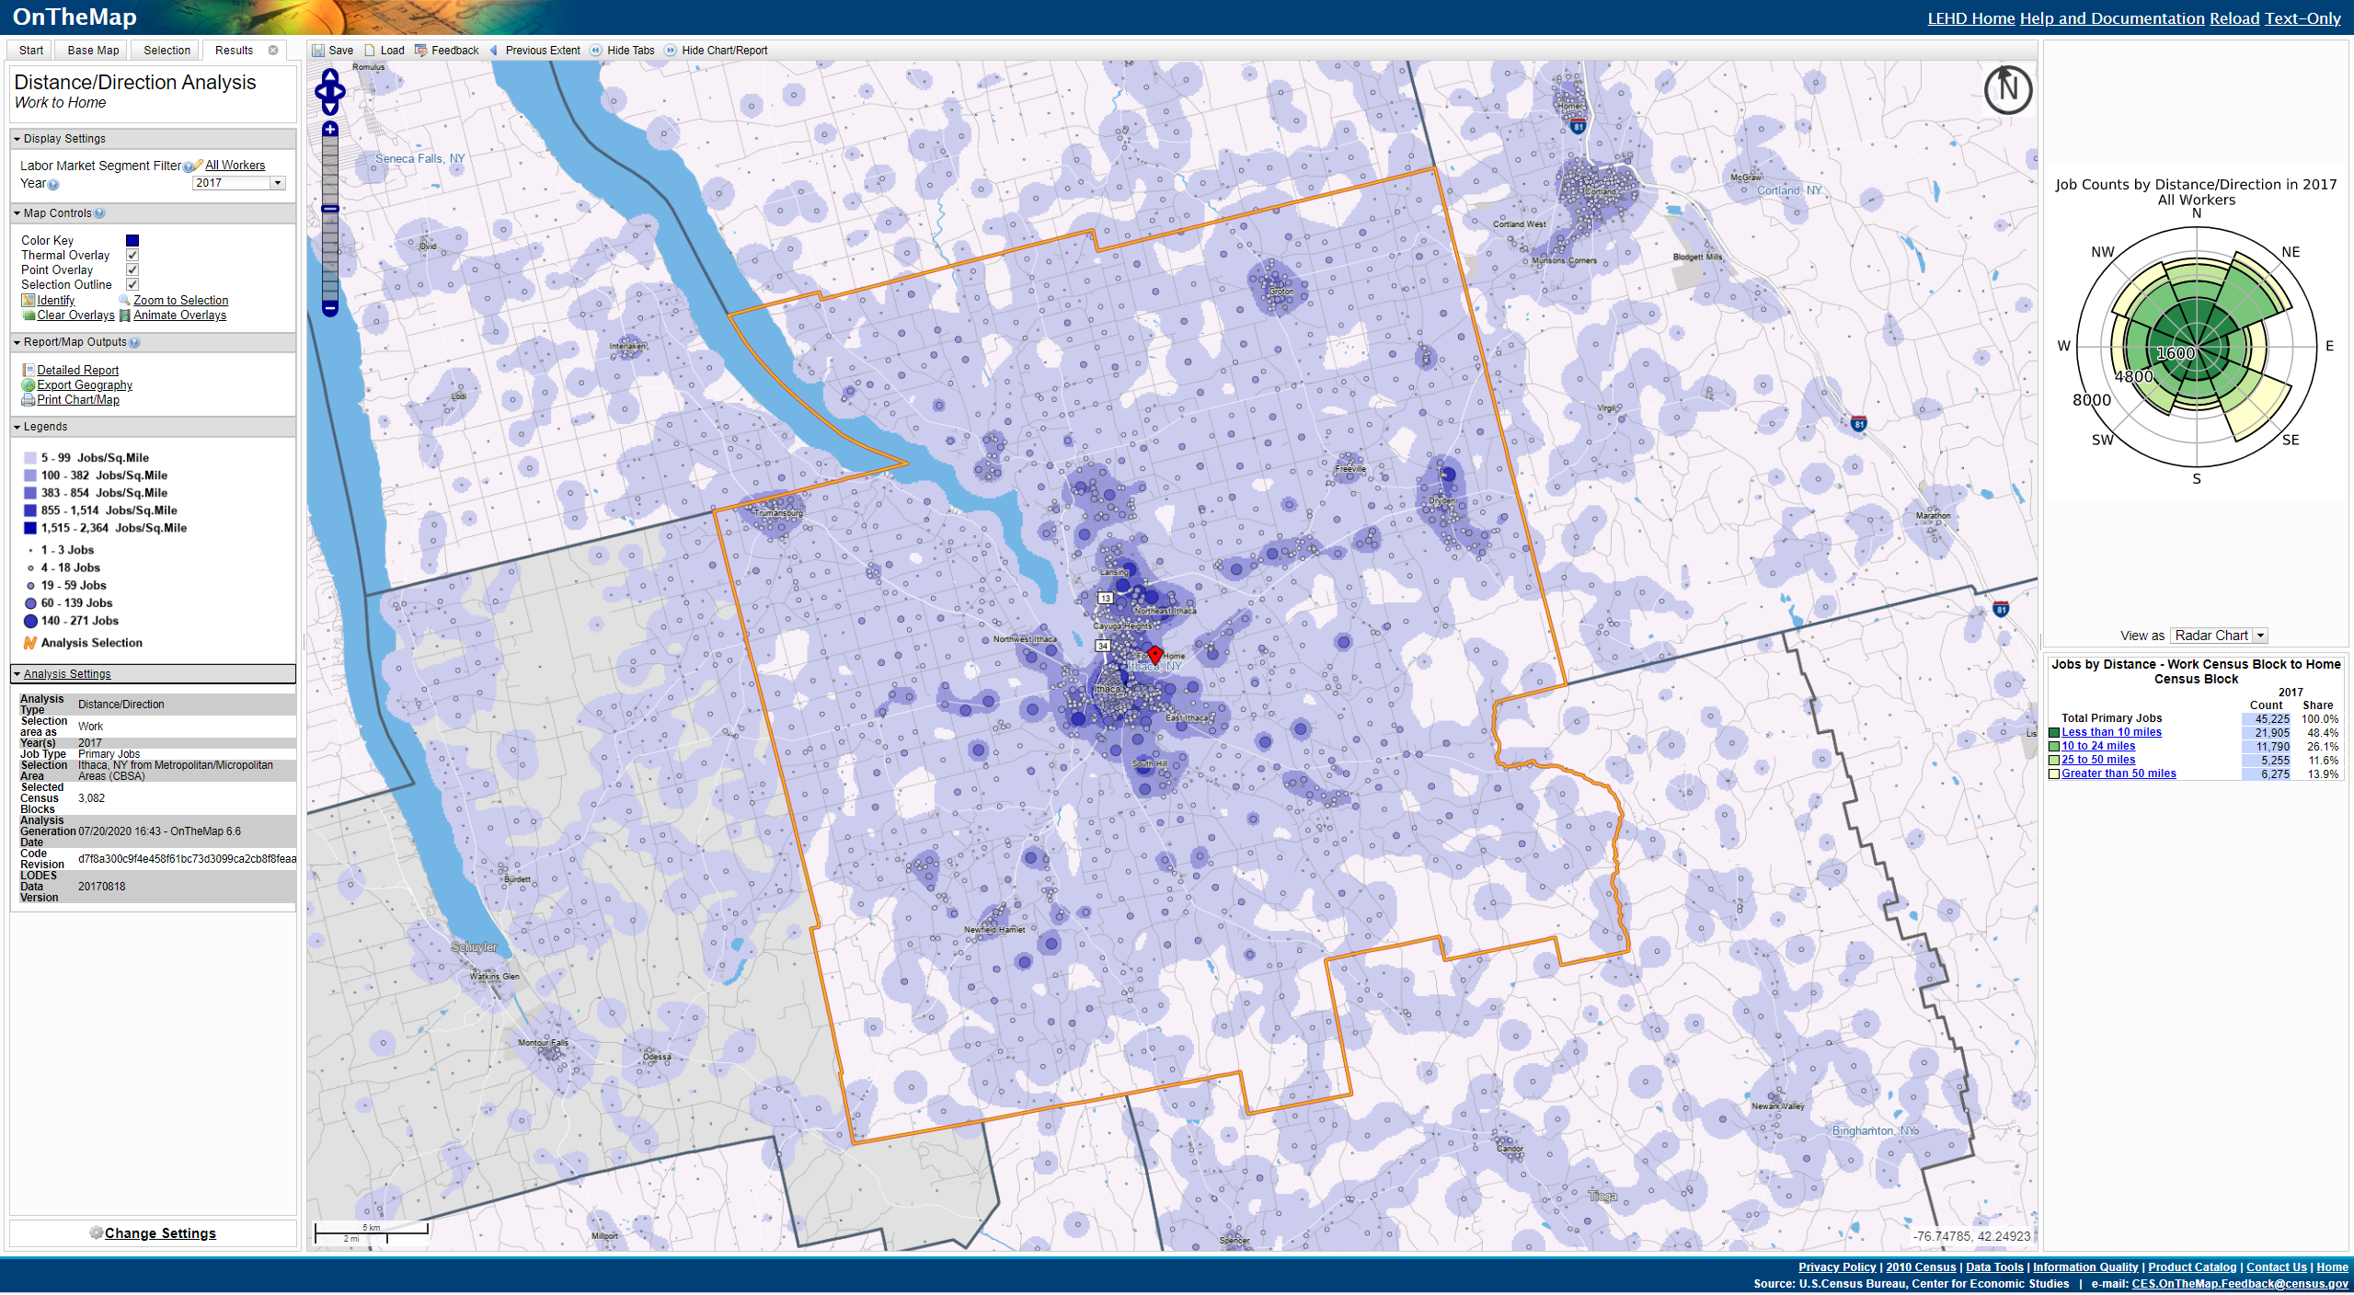
Notes:
To reproduce this analysis load the following as a text file:
{"selection_areas": [{"layer": "us_cbsa", "noun": "Ithaca, NY", "buffer_type": "none", "targetId": 1, "target_id": 1, "origin_app": "default", "wkt": "POINT(1584757.9280000001 718172.1360000001)", "buffers": {}}], "run_report": true, "extent": [1546342.1615311, 691239.89386073, 1624702.1615311, 745159.89386073], "analysis_settings": {"comparison_geom": "us_plc", "destination_rollup": "us_plc", "job_type": "jt01", "ac_segment": "s000", "analysis_type": "distance_direction_report", "geom_operation": "ignore", "year": [2017], "origin_dir": "home", "ap_segment": "s000", "origin_type": "work"}}

Slide 4
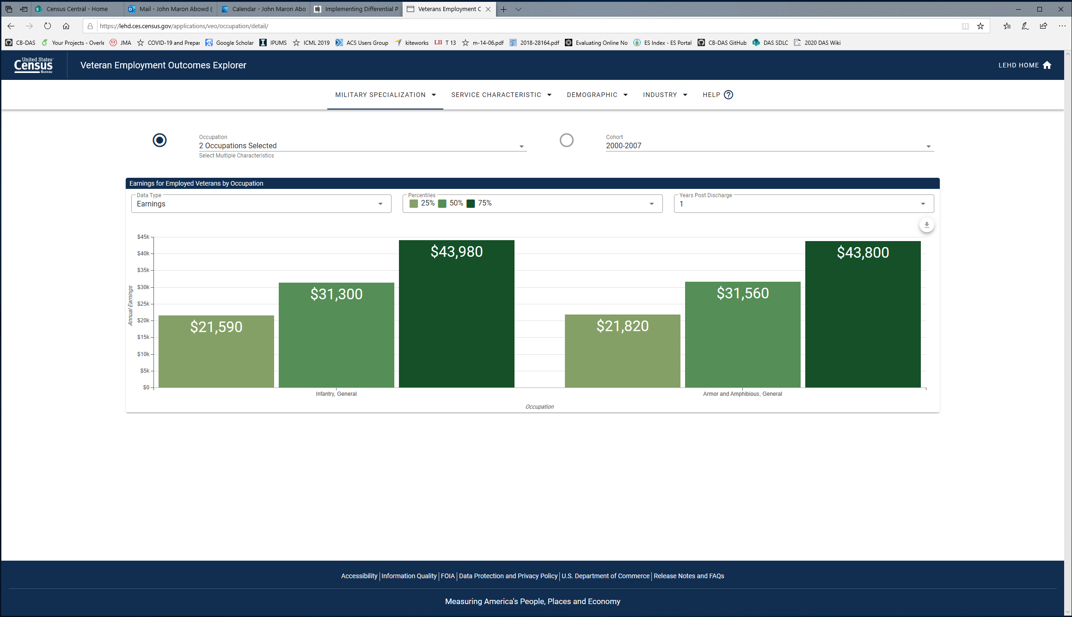

Slide 5
Major data products from the 2020 Census:
Apportion the House of Representatives (April 26, 2021)
Supply data to all state redistricting offices (August 16, 2021)
Demographic and housing characteristics (TBD)
Detailed demographic and housing characteristics (TBD)
American Indian, Alaska Native, Native Hawaiian data (TBD)
For the 2010 Census, this was more than 150 billion statistics from 15GB total data.

Slide 6
The Census Bureau’s Decision
Advances in computing power and the availability of external data sources make database reconstruction and re-identification increasingly likely, and the 2010 Census was already vulnerable.
The Census Bureau recognized that its traditional disclosure avoidance methods are increasingly insufficient to counter these risks.
To meet its continuing obligations to safeguard respondent information, the Census Bureau has committed to modernizing its approach to privacy protections.

Slide 7
The incredibly diverse user community is now engaged in the debate about accuracy v. privacy loss that publication of census results at this scale demands.

Slide 8
All 2020 Census Publications
Will all be processed by a collection of differentially private algorithms
Using a total privacy-loss budget set as policy, not hard-wired, determined by the Data Stewardship Executive Policy Committee
Preliminary code base, technical documents, and extensive demonstration products based on the 2010 Census confidential data have all been released to the public
More information: https://www.census.gov/newsroom/blogs/research-matters/2019/10/balancing_privacyan.html

Slide 9
Naïve Method: BottomUp or Block-by-Block
Apply differential privacy algorithms to the most detailed level of geography
Build all geographic aggregates from those components as a post-processing
This is similar to the local differential privacy implementations in the Chrome browser, iOS, and Windows 10.

Slide 10
The Census TopDown Algorithm (TDA)
Take differentially private measurements at every level of the Census geographic hierarchy
Moving from the United States to the census block post-process:
Solve a non-negative least squares optimization to get non-negative tables at each level of the geographic hierarchy, always consistent with the levels above
Solve a mixed integer linear program to get non-negative, integer tables at each level of the geographic hierarchy, always consistent with the levels above
Generate micro-data from these post-processed tables from the block-level detailed tables (an exact image of a unique Microdata Detail File)

Slide 11
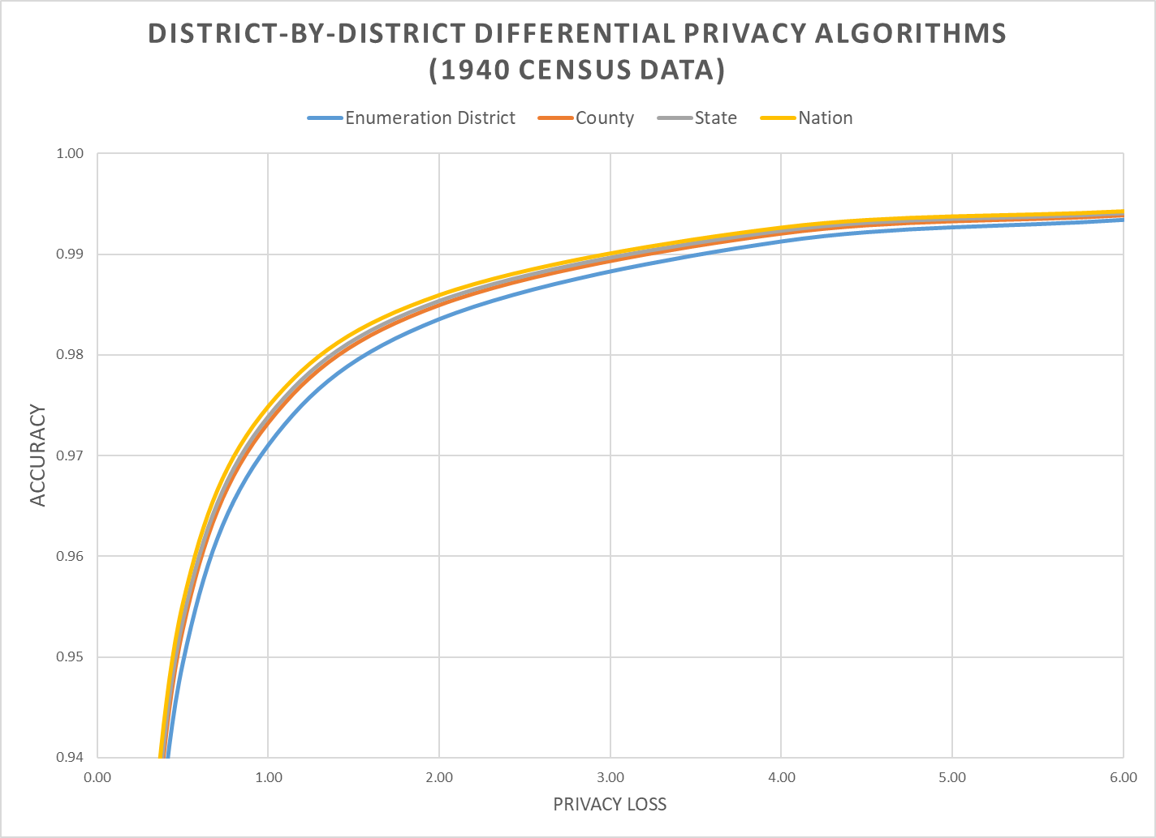

Slide 12
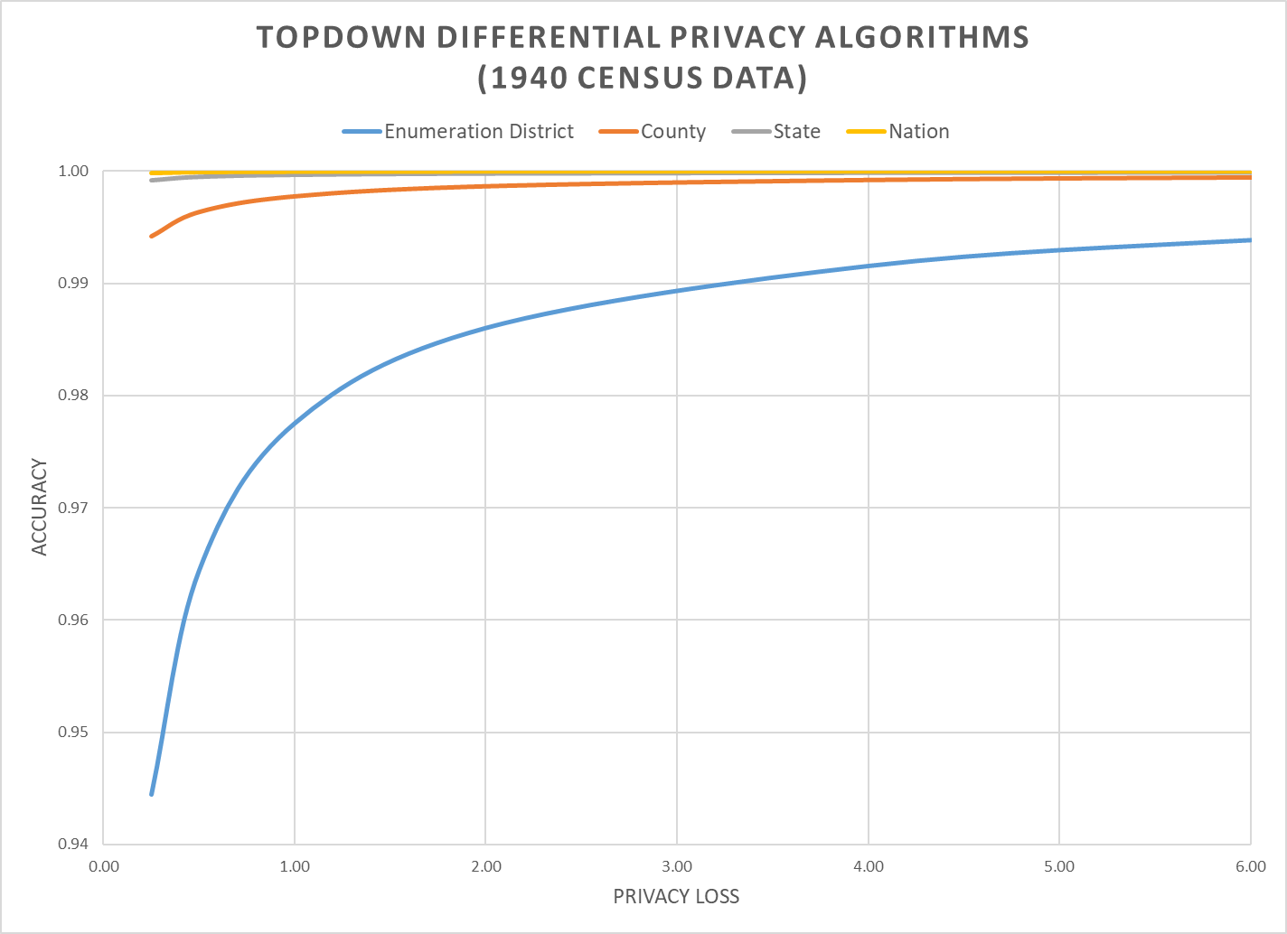

Slide 13
If you feed TDA 11 billion differentially private measurements, it will do a good job that completely satisfies no one.

Slide 14
Accurate, but to whom?
DAS operates under interpretable formal privacy guarantees, given privacy-loss budgets
Accuracy properties depend upon the output metric (use case)
Distinct groups of data users will have a particular analyses they wish to be accurate
Tuning accuracy for a given analysis can reduce accuracy for other analyses
Policy makers must consider reasonable overall accuracy metrics for privacy tradeoffs

Slide 15
Deep Dive: Redistricting Data
Legislative districts for politically defined entities of arbitrary size
Must be (approximately) equal populations in each district
Districts must be consistent with Section 2 scrutiny under the 1965 Voting Rights Act
Large minority populations cannot be clustered into a few districts
Majority-minority districts (approximately 50%+ minority population) must be drawn when feasible
Focus statistics: total population, ratio largest race/ethnic population to total population

Slide 16
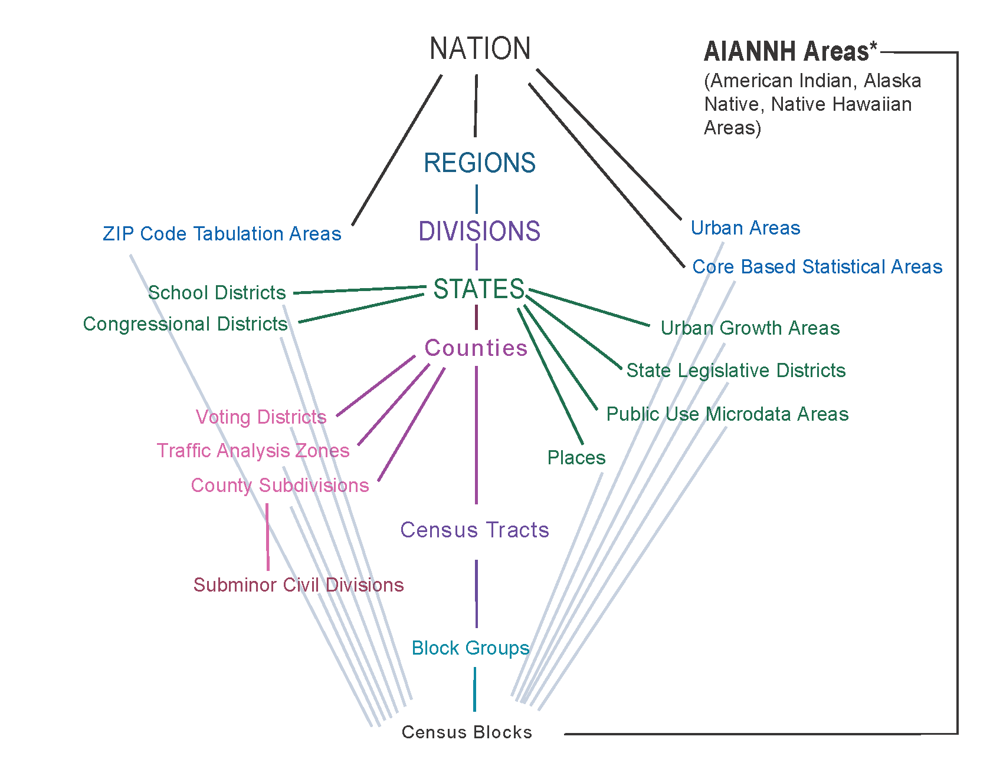

Slide 17
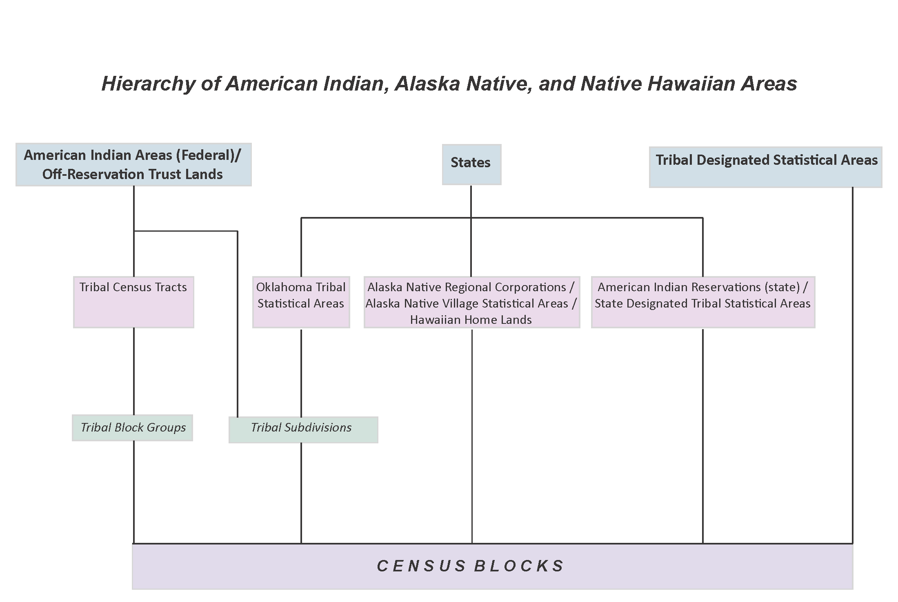

Slide 18
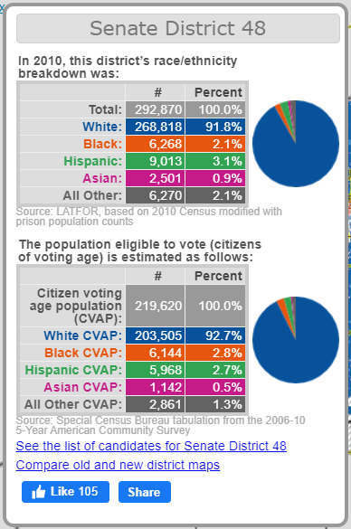
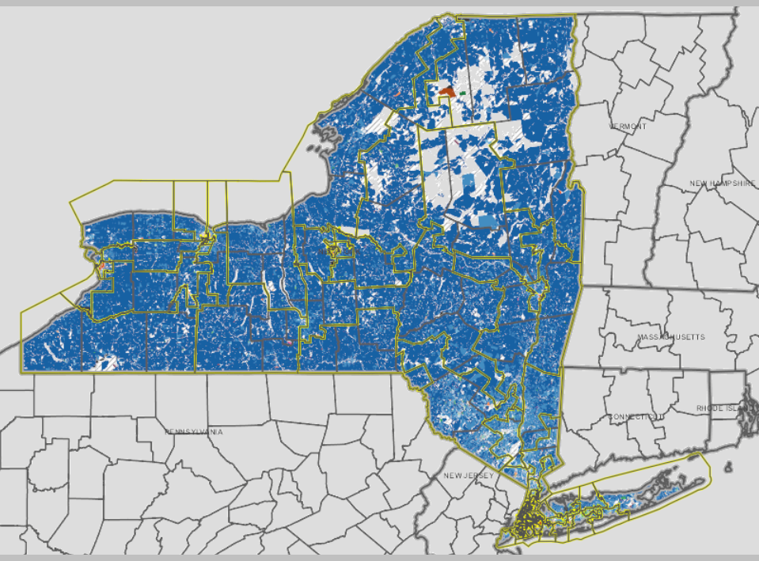

Slide 19

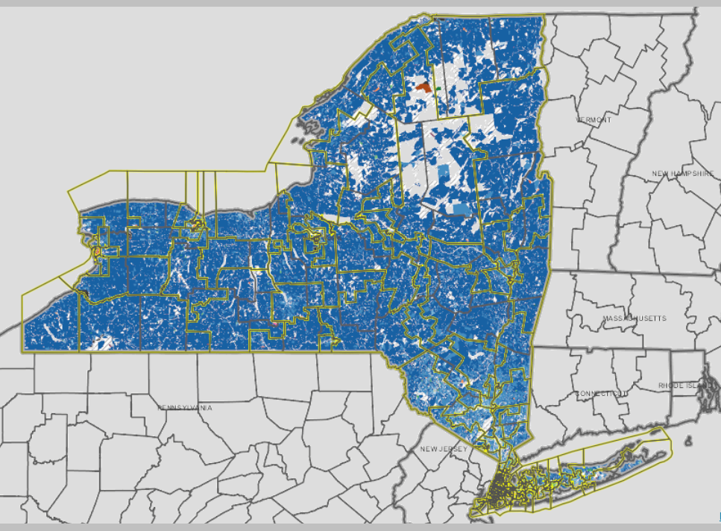

Slide 20
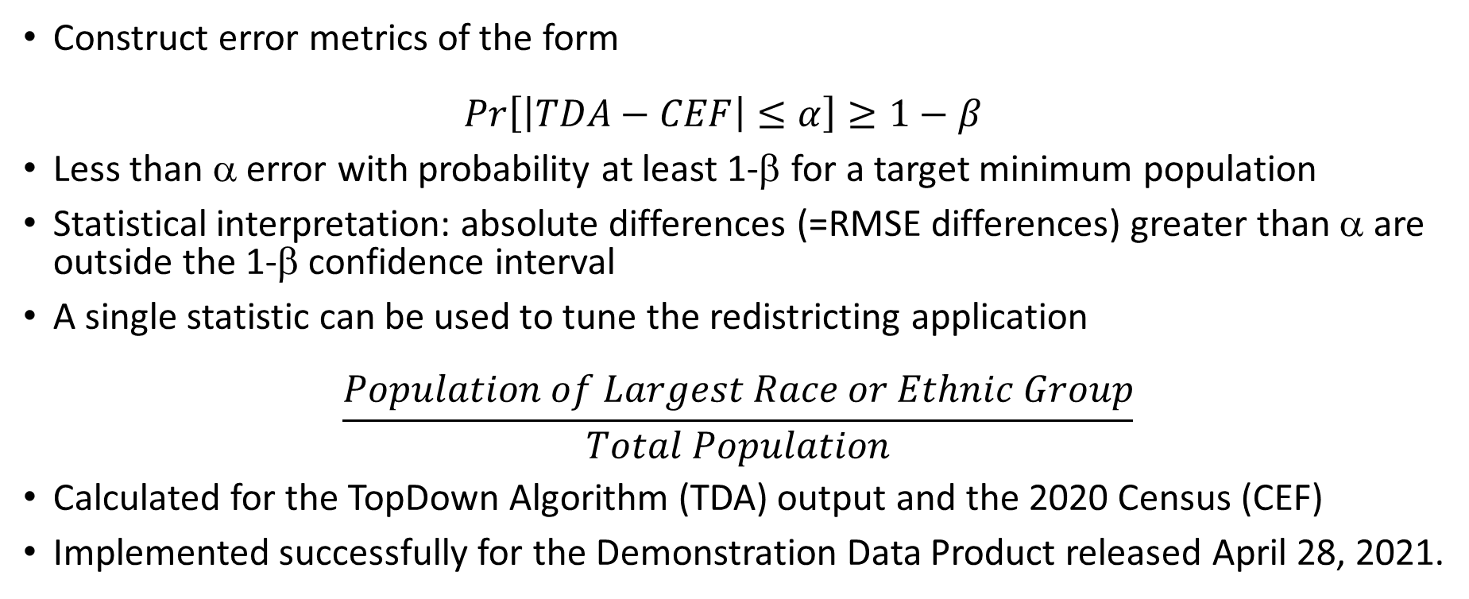
How to reconcile these statistics
Construct error metrics of the form $Pr\left[\left|TDA−CEF\right|≤α\right]≥1−β$
Less than α error with probability at least 1-β for a target minimum population
Statistical interpretation: absolute differences (=RMSE differences) greater than α are outside the 1-β confidence interval
A single statistic can be used to tune the redistricting application
$$\frac{Population of Largest Race or Ethnic Group}{Total Population}$$
Calculated for the TopDown Algorithm (TDA) output and the 2020 Census (CEF)
Implemented successfully for the Demonstration Data Product released April 28, 2021.

Slide 21
What do the redistricting data do?
Total differentially private measurements (queries): 16.6 billion
Global ρ = 2.63 (ε, δ) equivalent = (17.44, 10⁻¹⁰) [U.S. persons and housing units]
Total block-level tables 29.4 million
Total block-level statistics 3.4 billion
Total independent block-level statistics 1.5 billion
Accuracy of populations and largest race/ethnic group fit for redistricting and Voting Rights Act scrutiny for populations of at least 150, which is much smaller than any example district used in VRA
Census TopDown Algorithm generated these (algorithms discussed elsewhere)

Slide 22
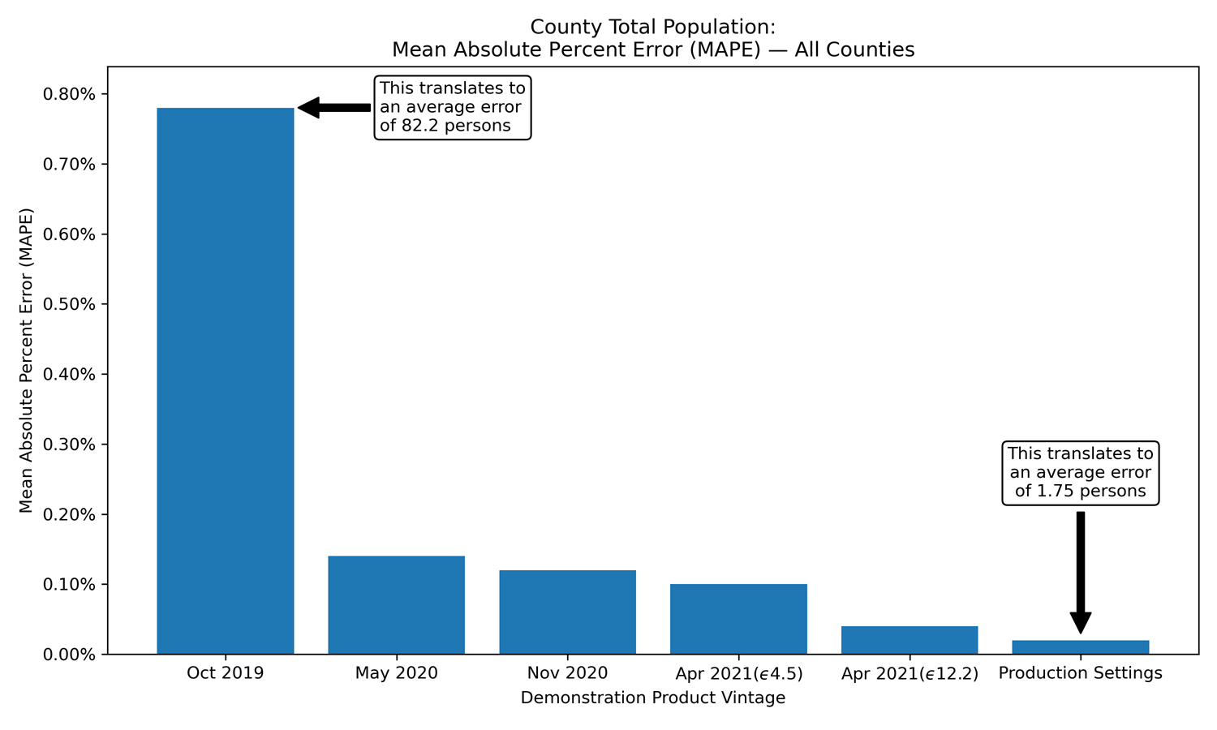
Total Population – County

Slide 23
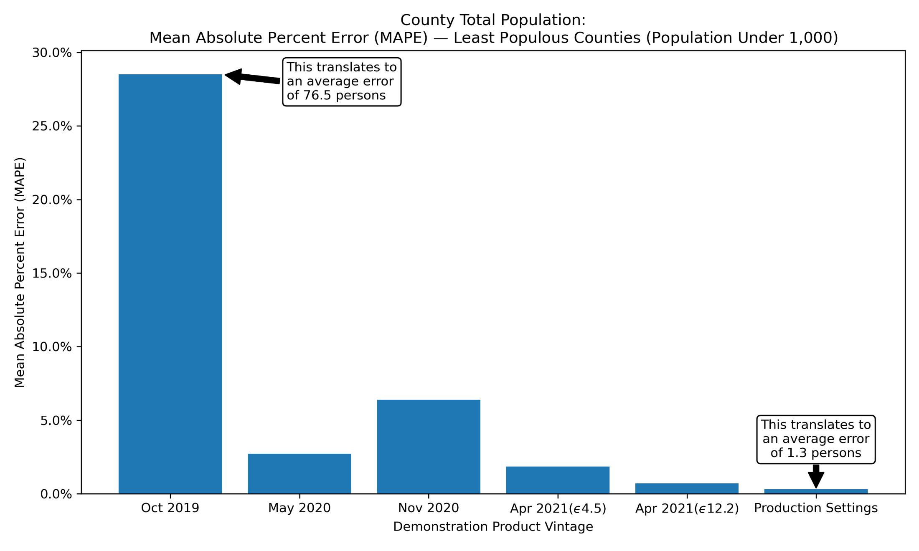
Total Population – County

Slide 24
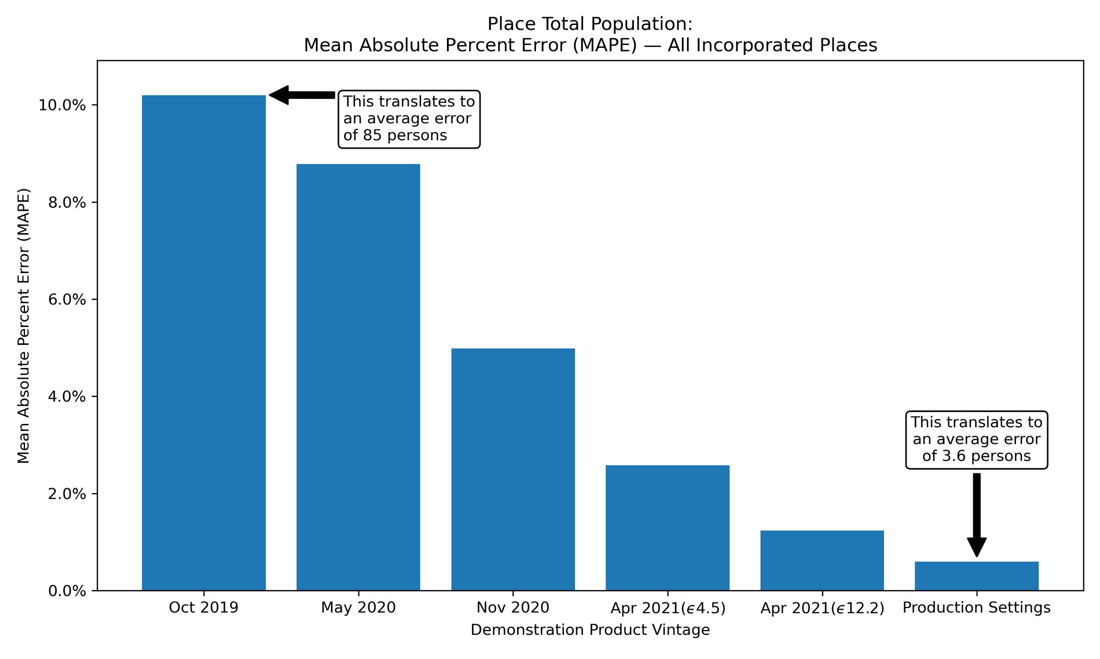
Total Population – Place

Slide 25
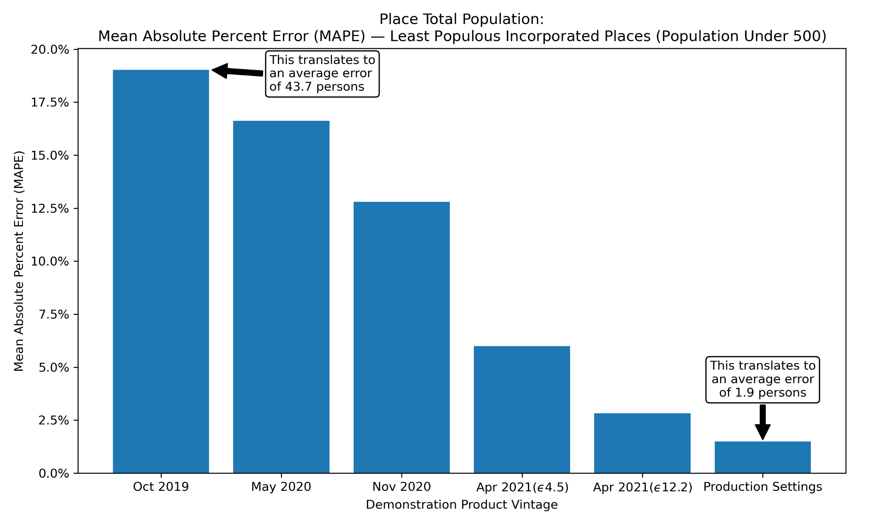
Total Population – Place

Slide 26
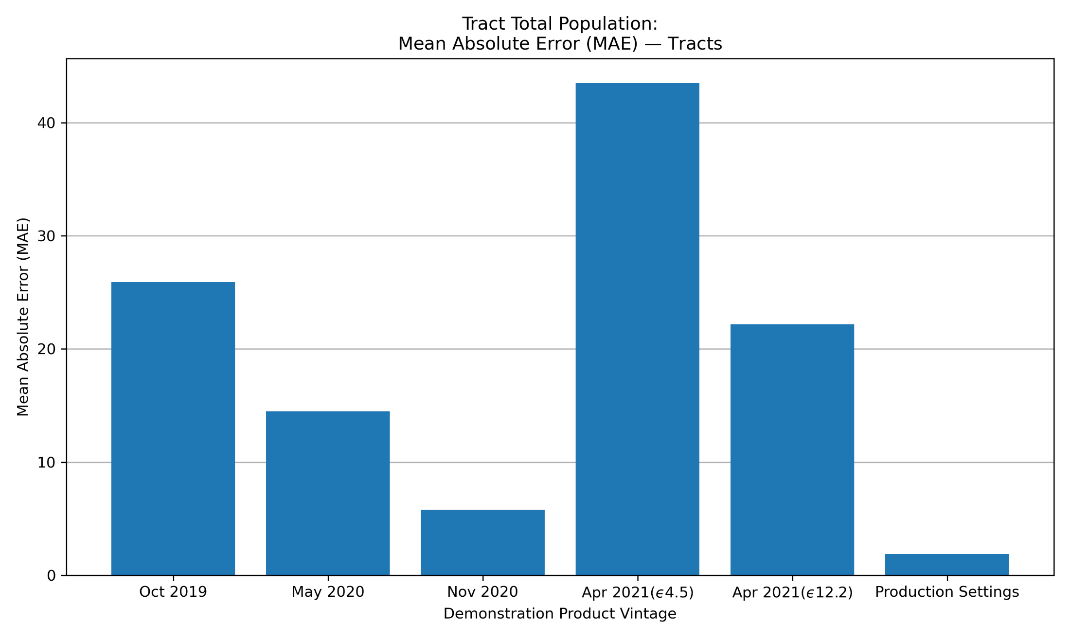
Total Population – Tract

Slide 27
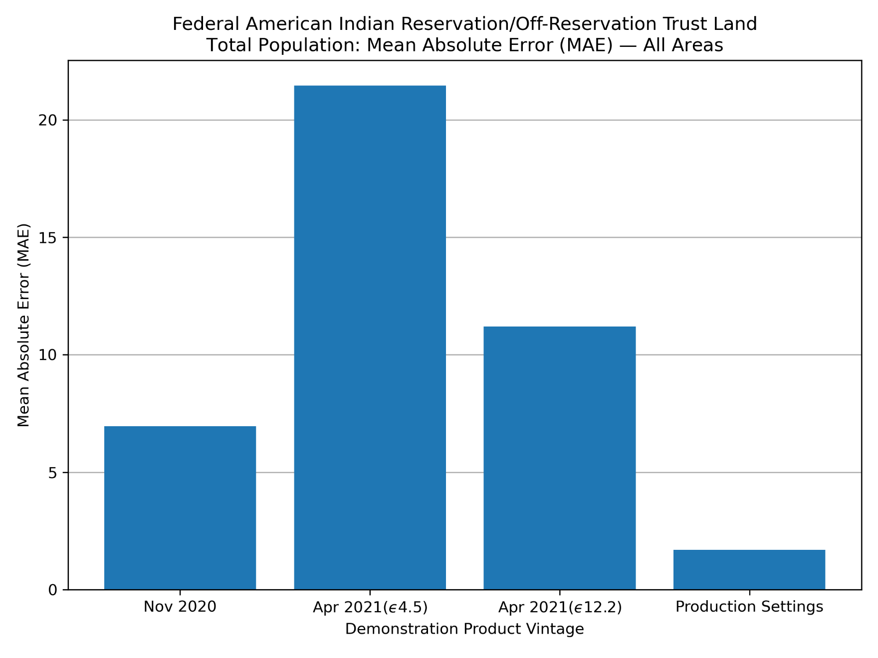
Total Population – Federal American Indian Reservation

Slide 28
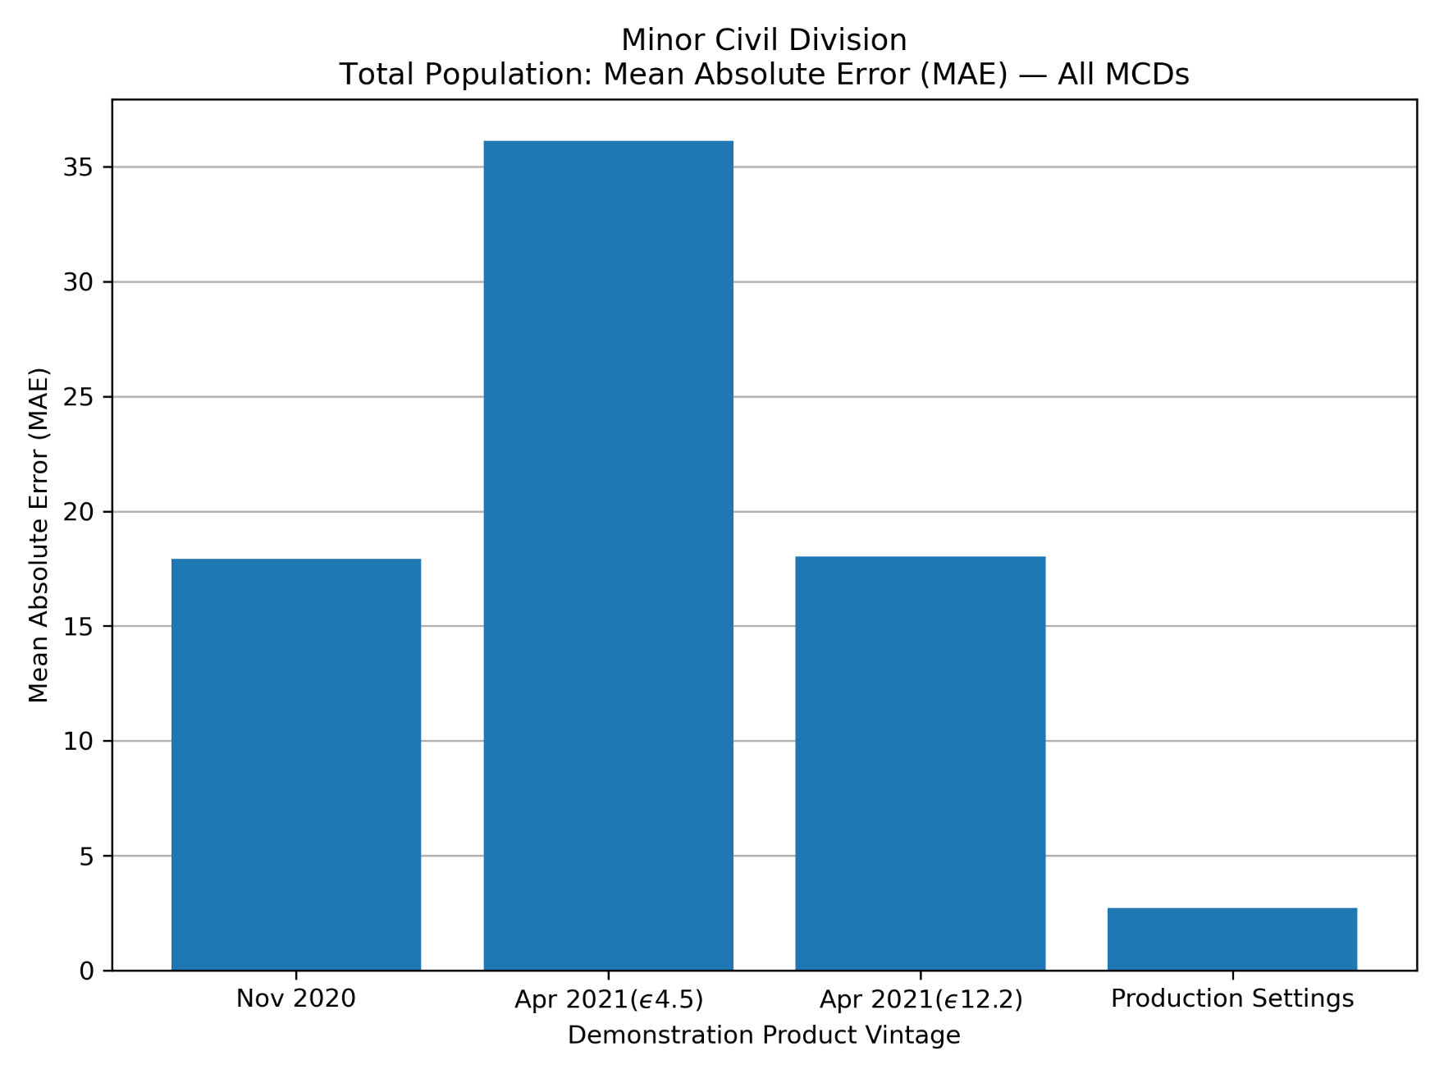
Total Population – Minor Civil Divisions

Slide 29
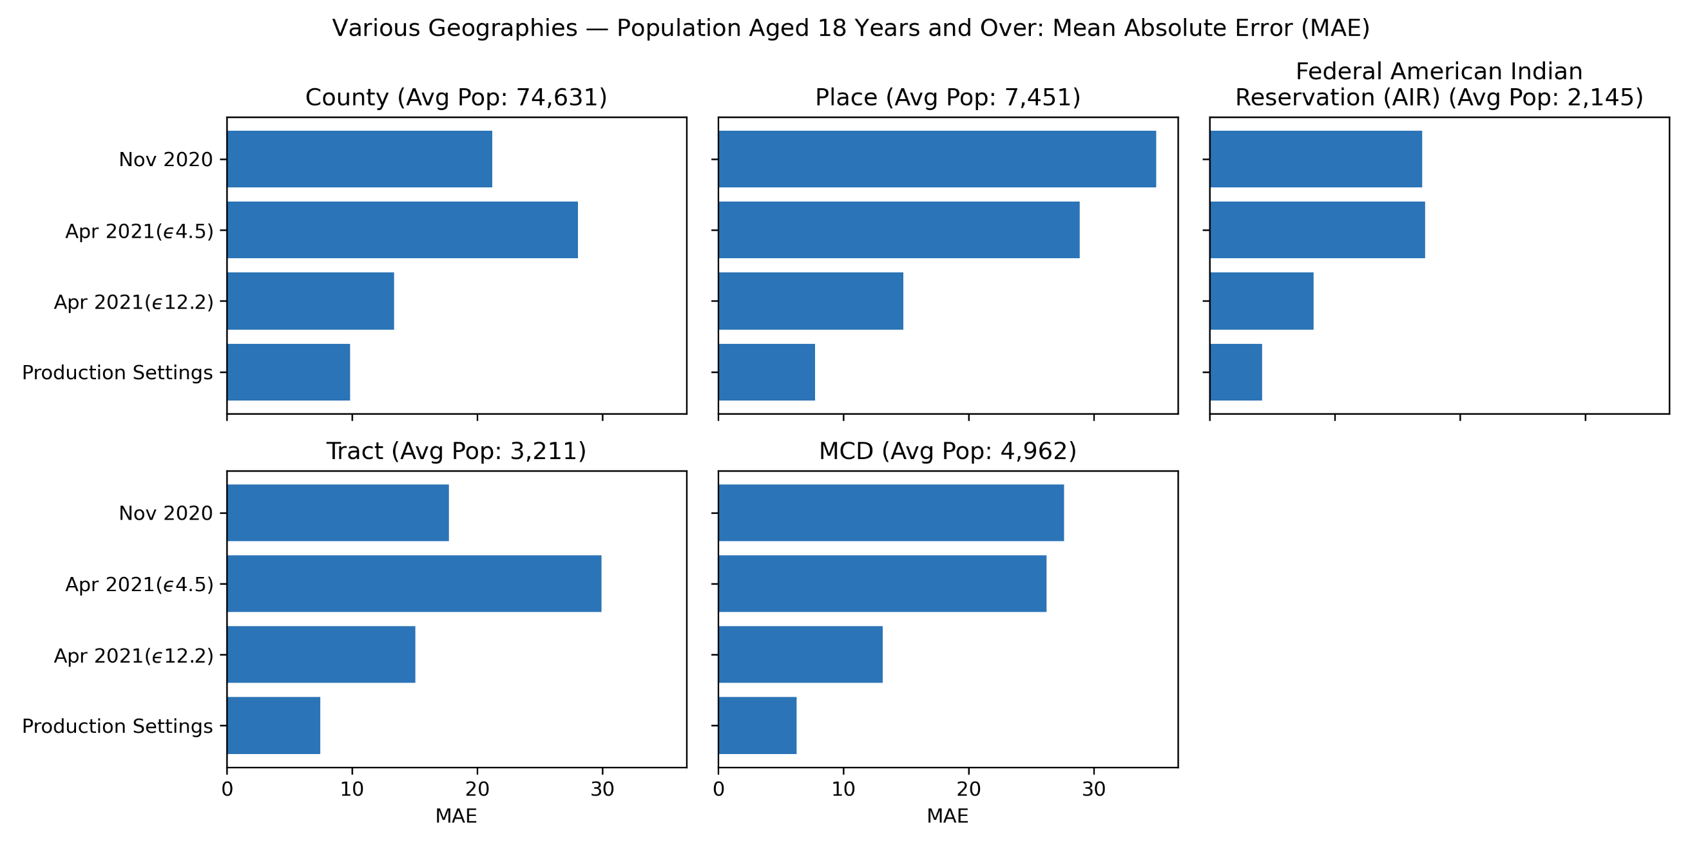
Total Population Aged 18+ – Various Geos.

Slide 30
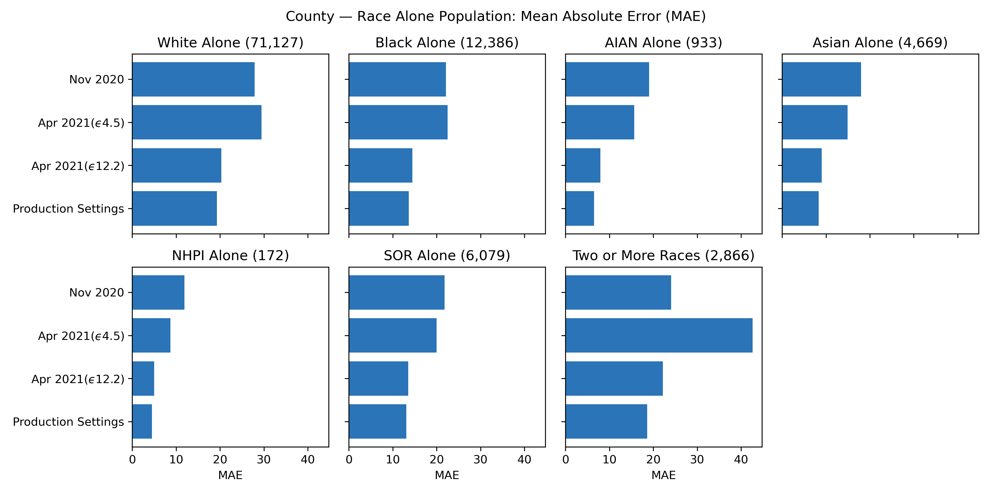
Race Alone – County

Slide 31
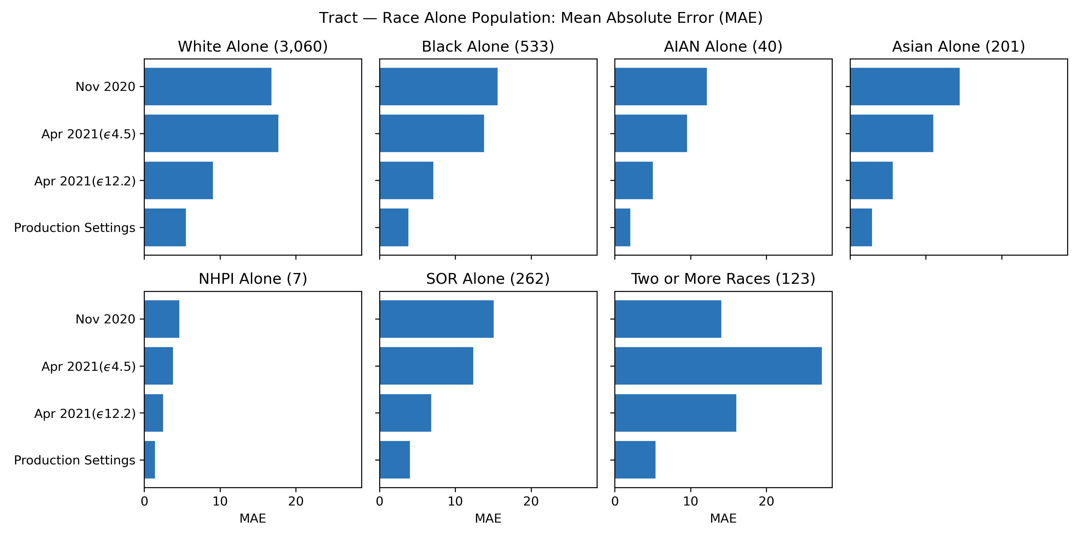
Race Alone – Tract

Slide 32
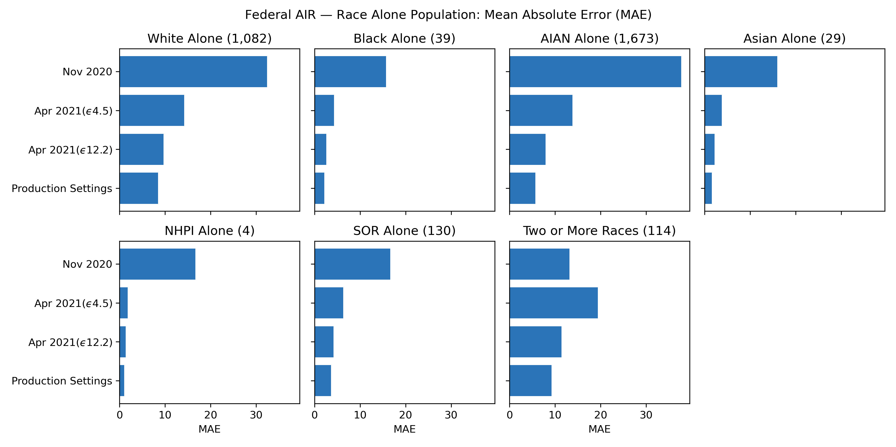
Race Alone – Federal AIR

Slide 33
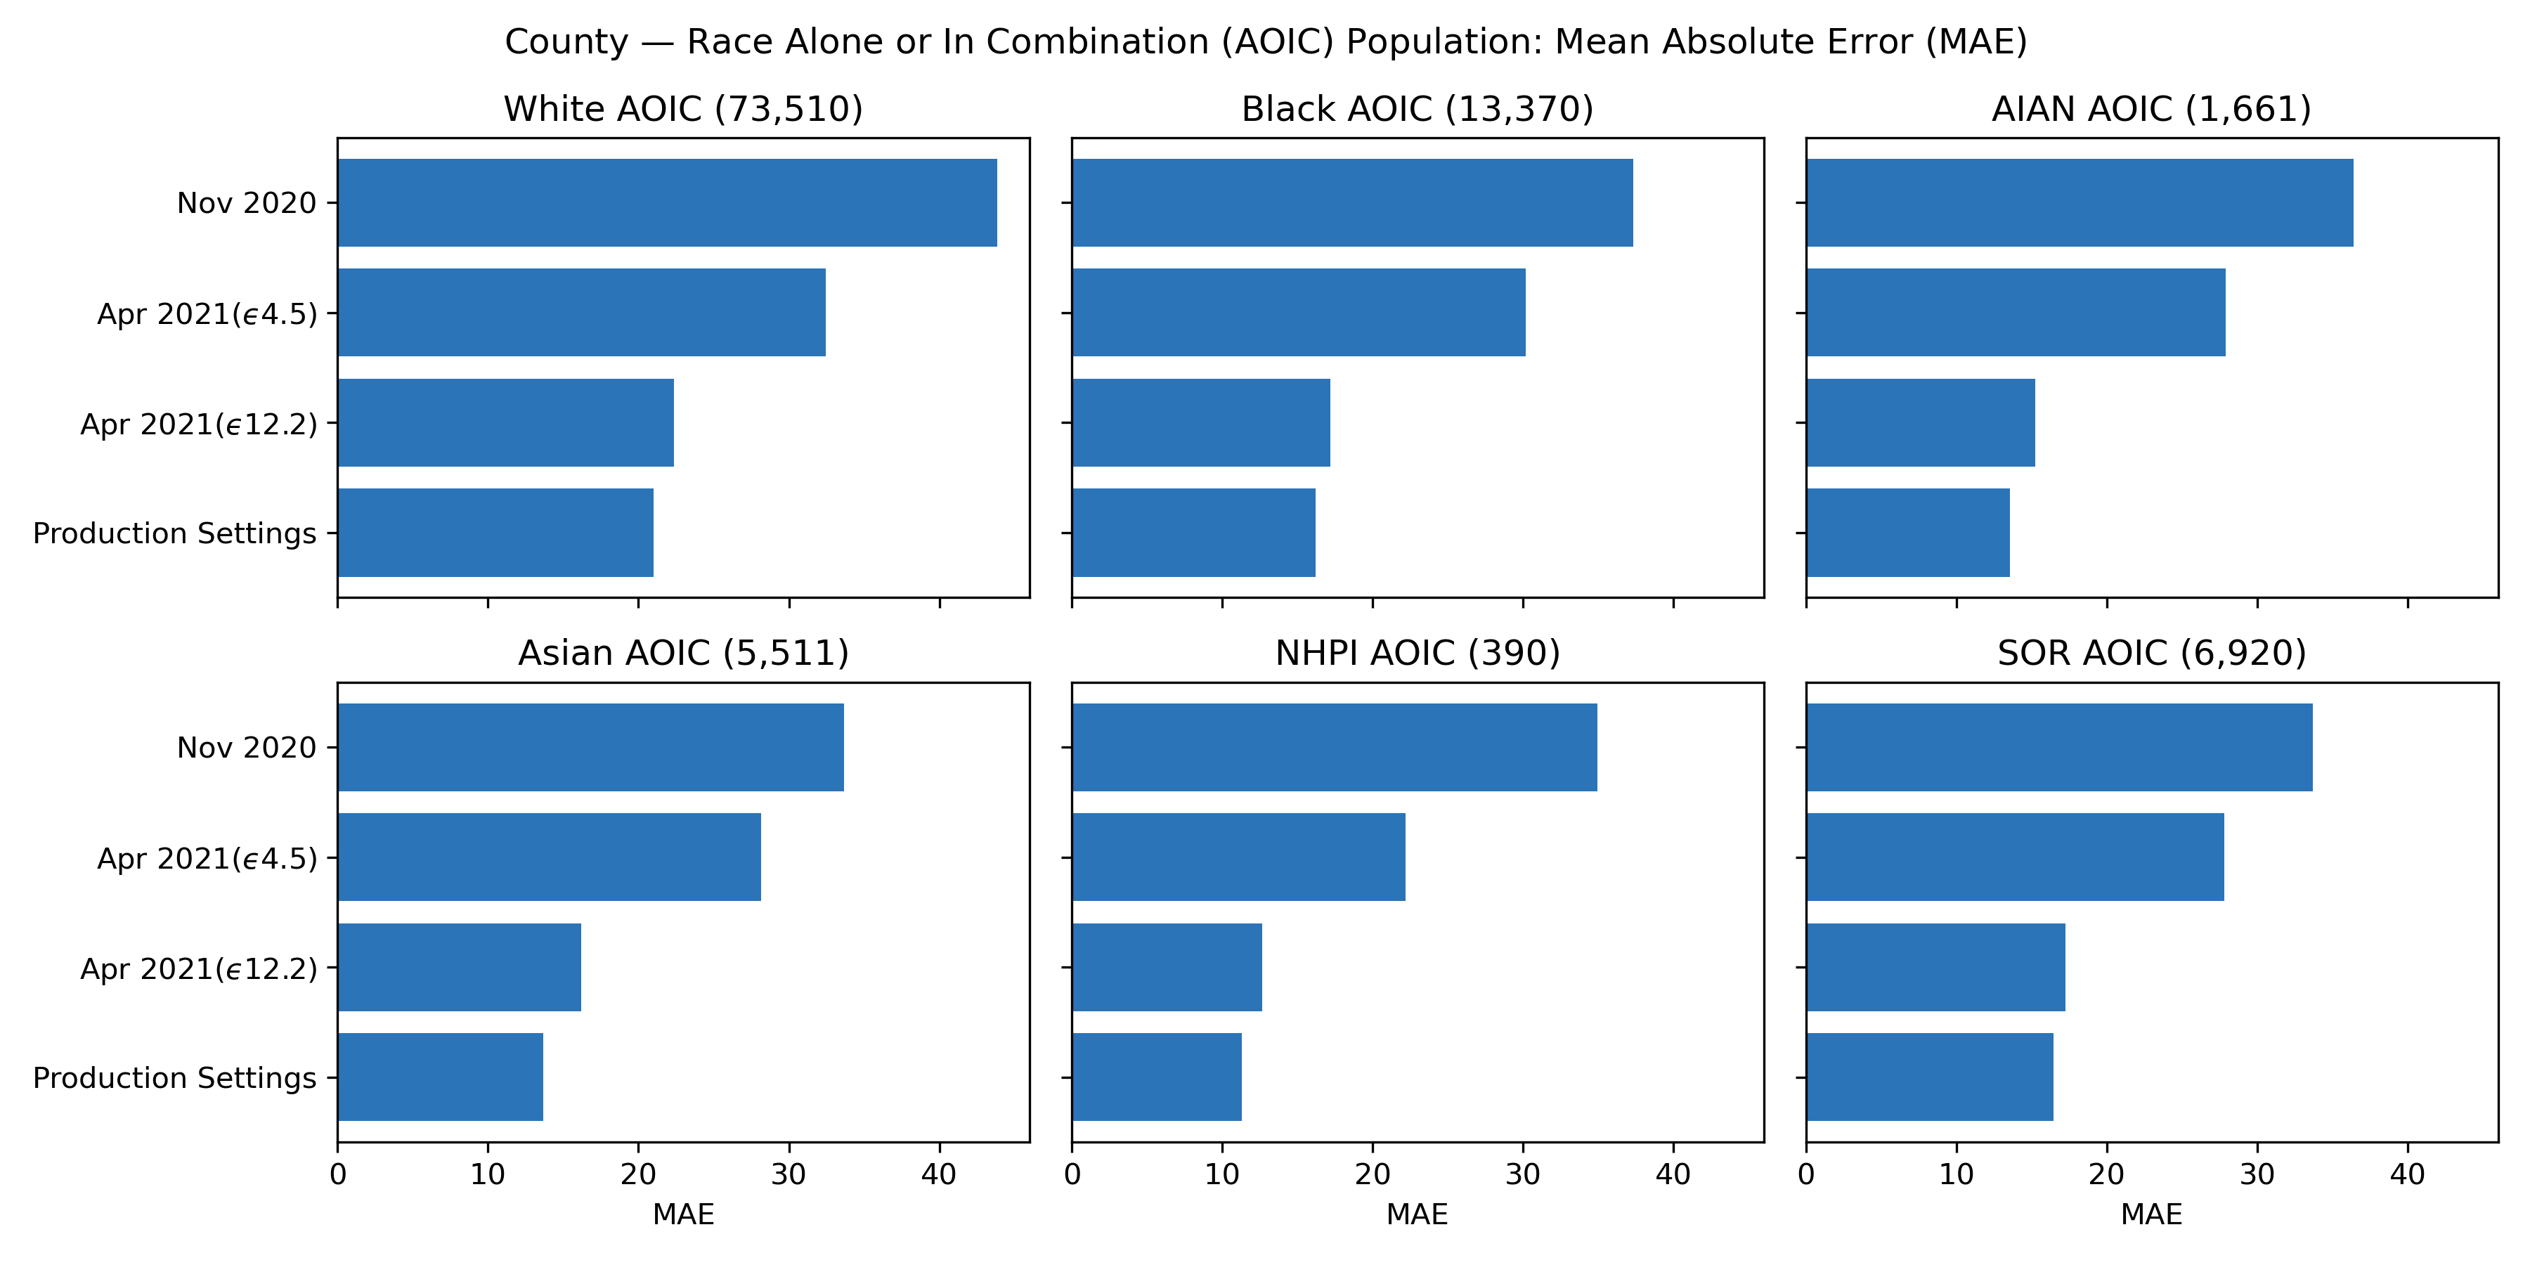
Race Alone or in Combination – County

Slide 34
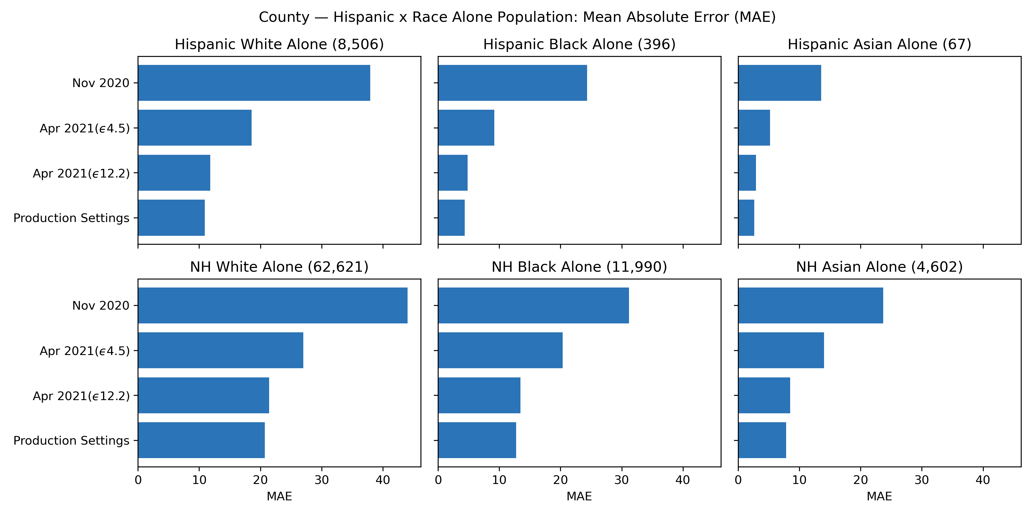
Hispanic x Selected Race Alone – County

Slide 35
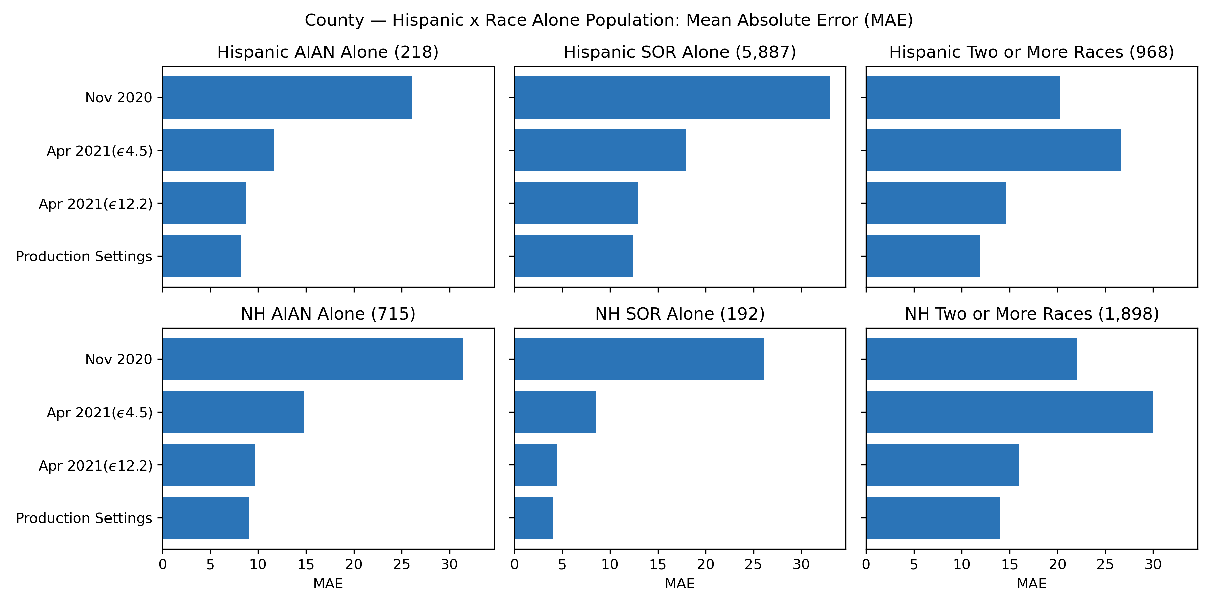
Hispanic x Selected Race Alone – County

Slide 36
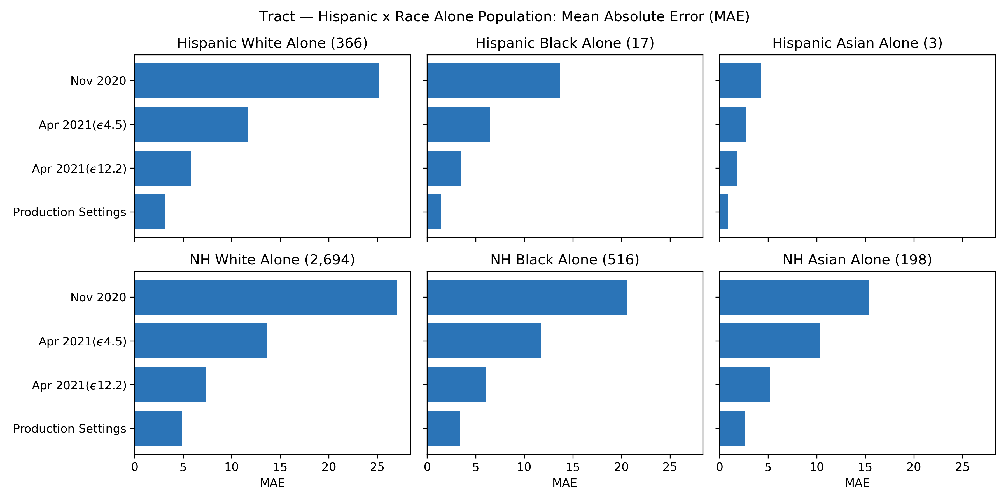
Hispanic x Selected Race Alone – Tract

Slide 37
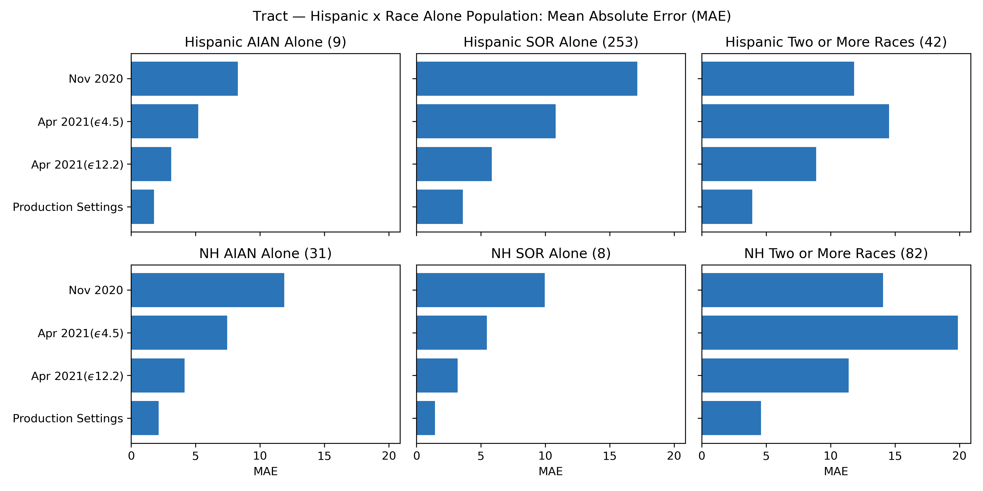
Hispanic x Selected Race Alone – Tract

Slide 38
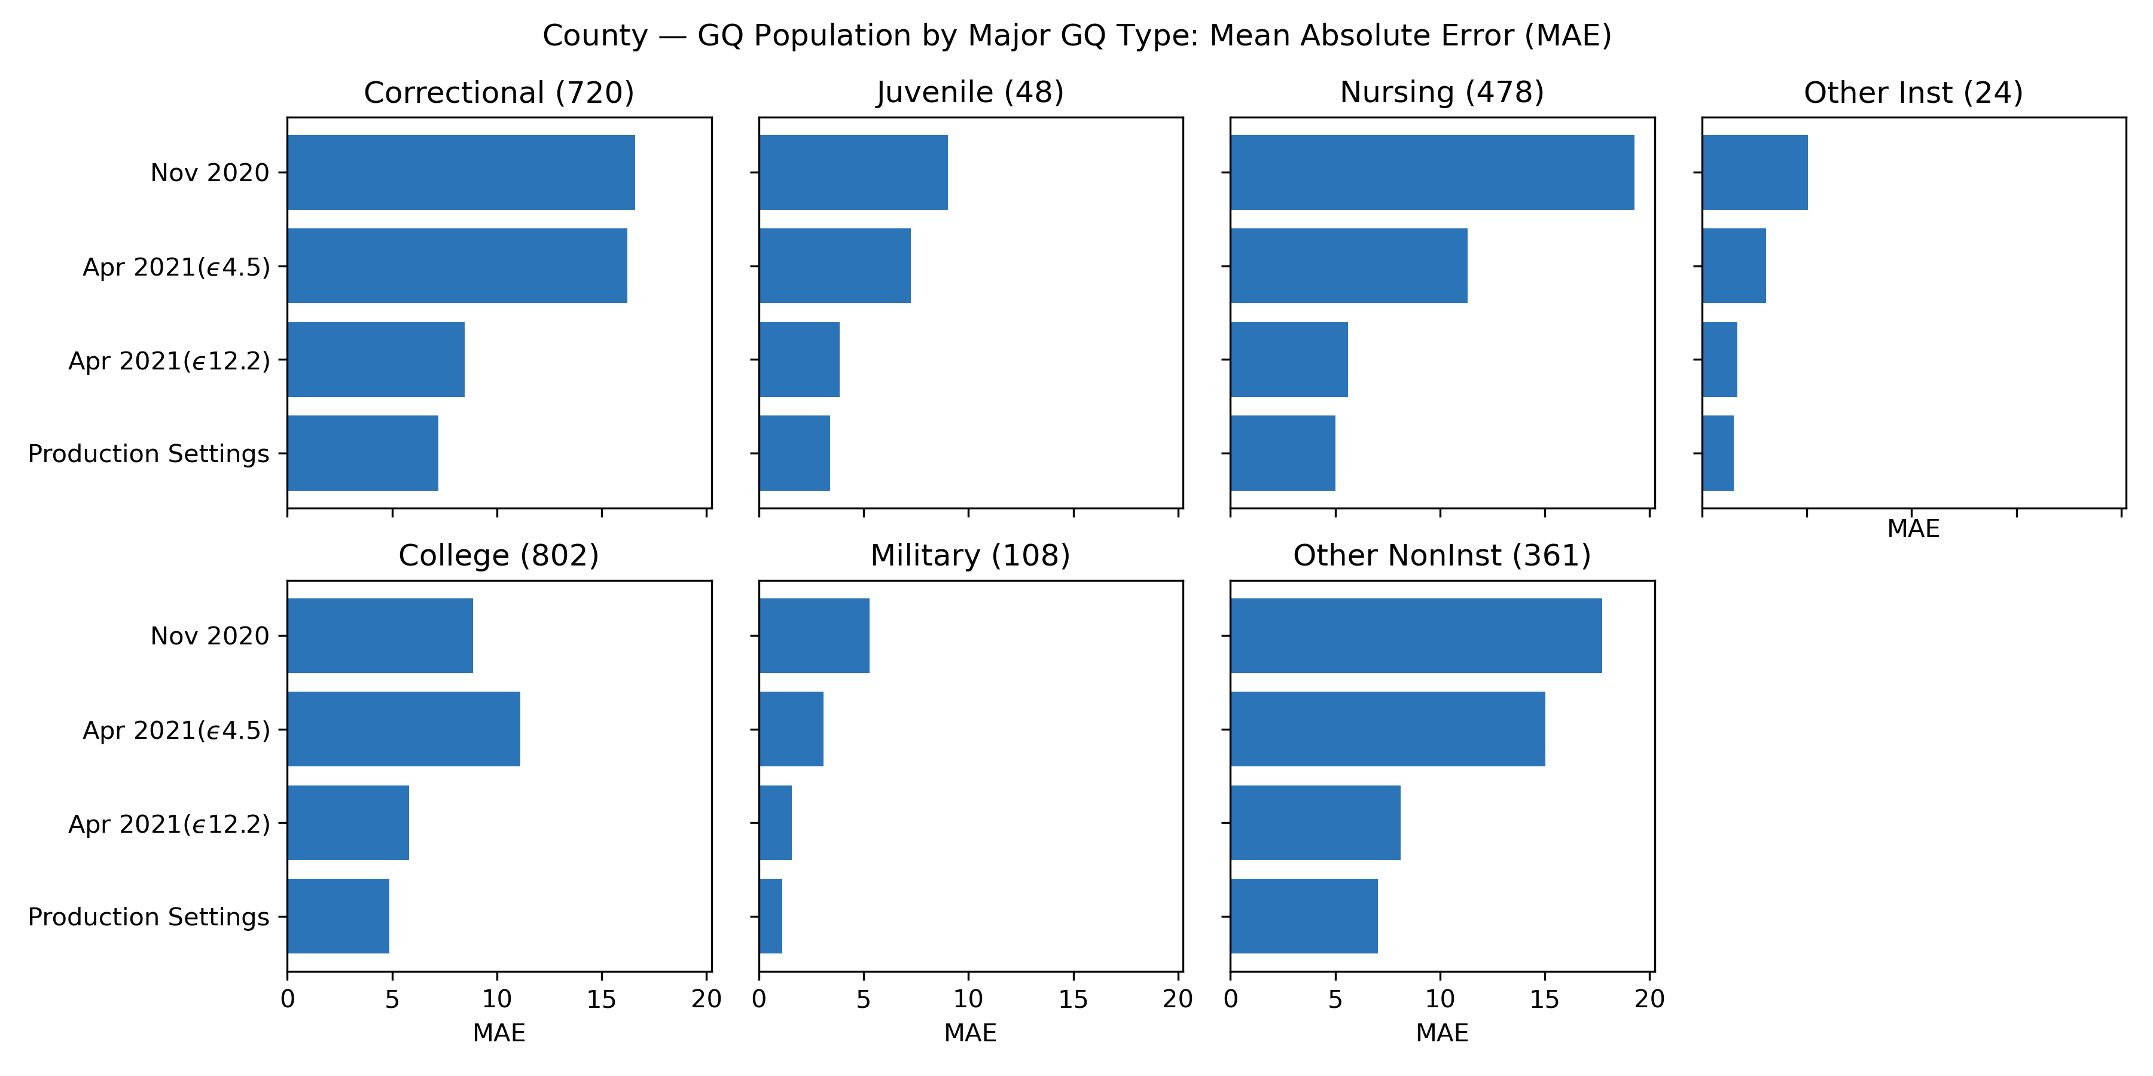
GQ Major Type – County

Slide 39
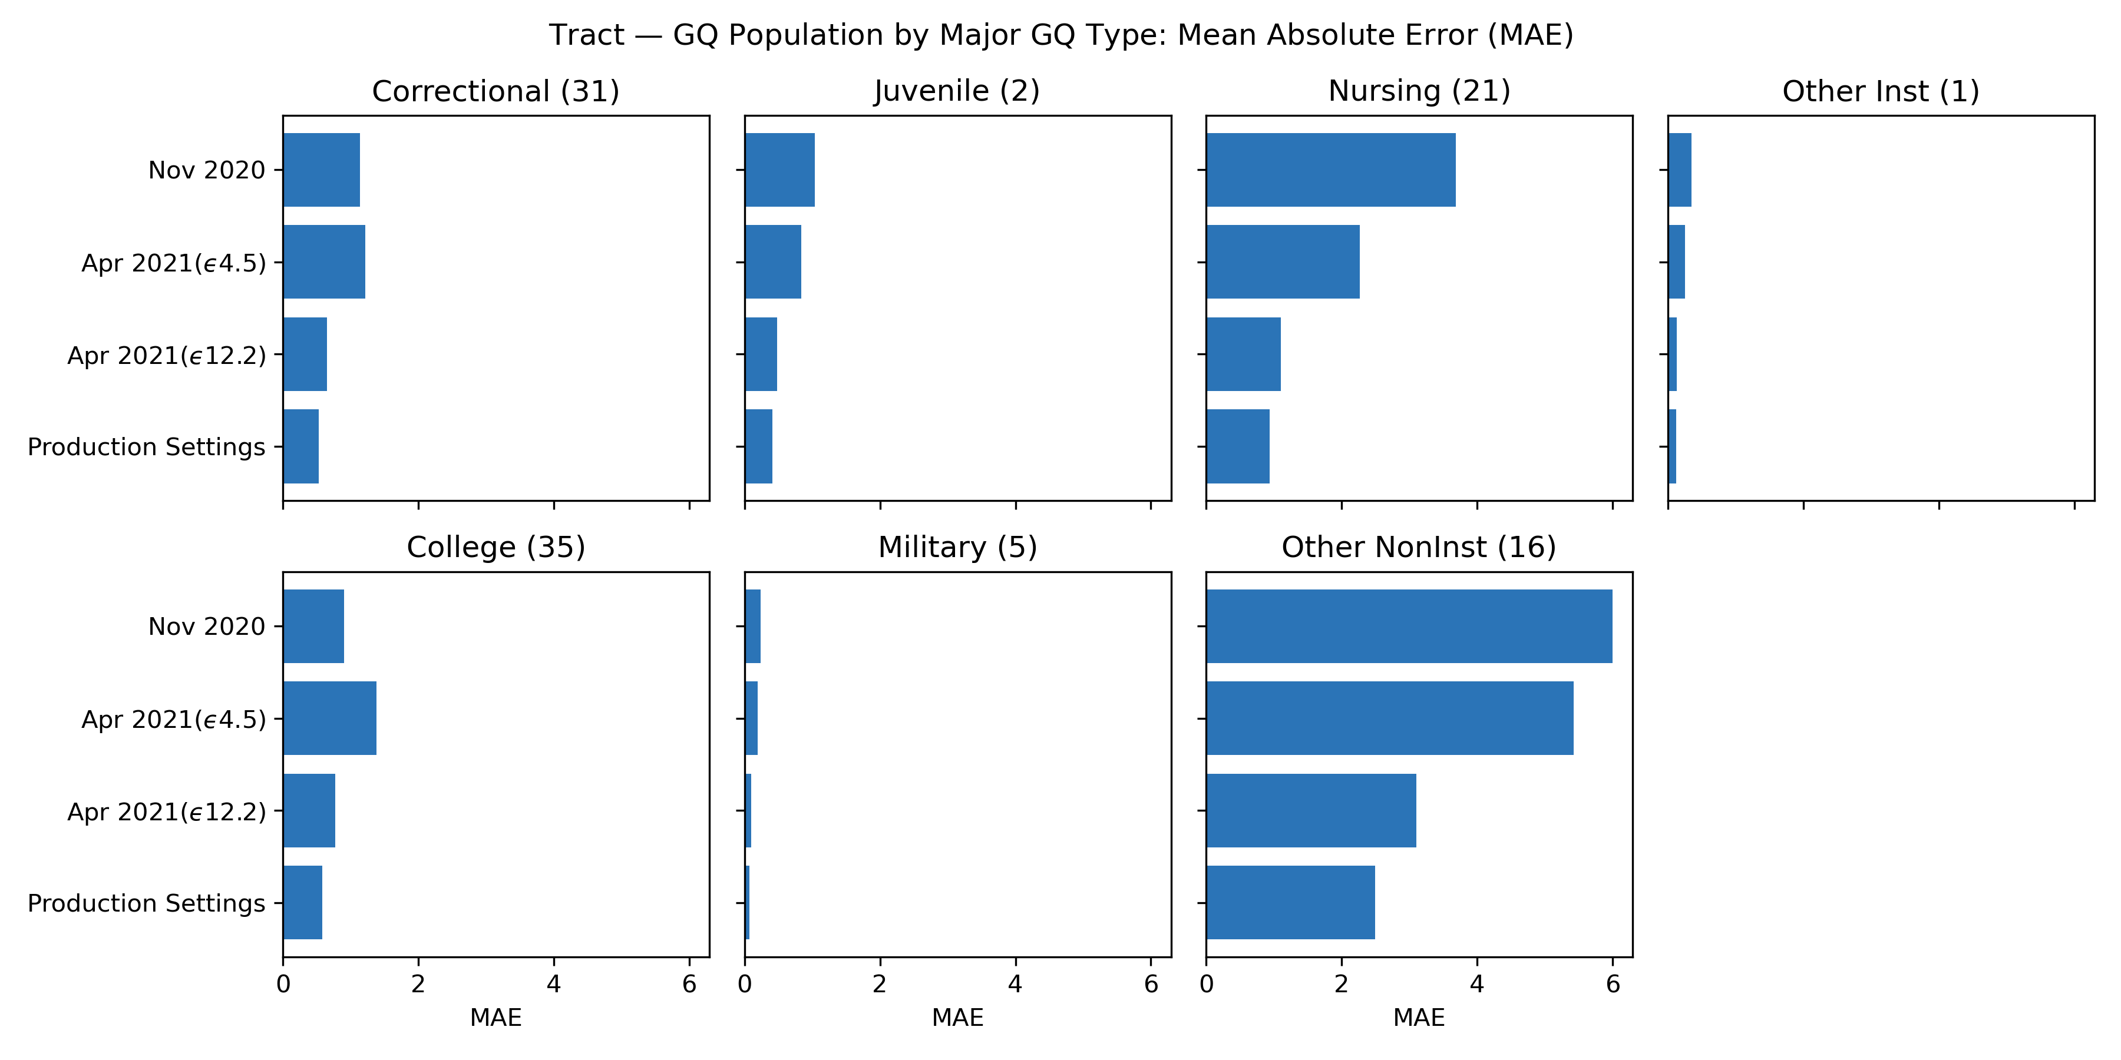
GQ Major Type – Tract

Slide 40
Addressing Bias
April 2021 PPMF
Production Settings
Diversity Quintile | Mean Difference In Total Population
0 – Least Diverse | 5.04
1 | 4.24
2 | 0.99
3 | -2.21
4 – Most Diverse | -8.07
Diversity Quintile | Mean Difference In Total Population
0 – Least Diverse | -0.375
1 | 1.009
2 | 0.997
3 | -0.303
4 – Most Diverse | -1.352
Block
Groups
Diversity Quintile | Mean Difference In Total Population
0 – Least Diverse | 15.95
1 | 11.15
2 | 3.01
3 | -6.17
4 – Most Diverse | -23.94
Diversity Quintile | Mean Difference In Total Population
0 – Least Diverse | 0.029
1 | 0.045
2 | 0.000
3 | -0.020
4 – Most Diverse | -0.053
Tracts

Slide 41
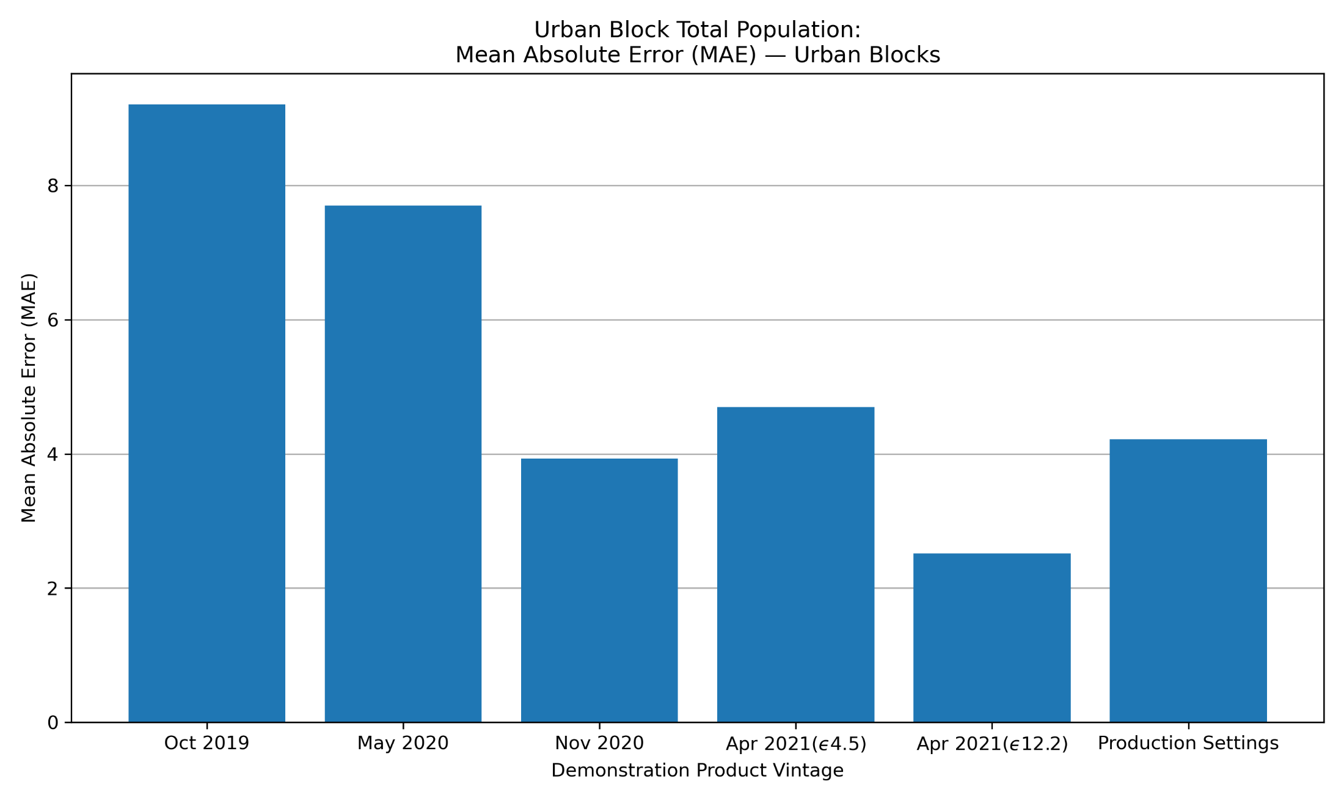
Total Population – Urban Block

Slide 42
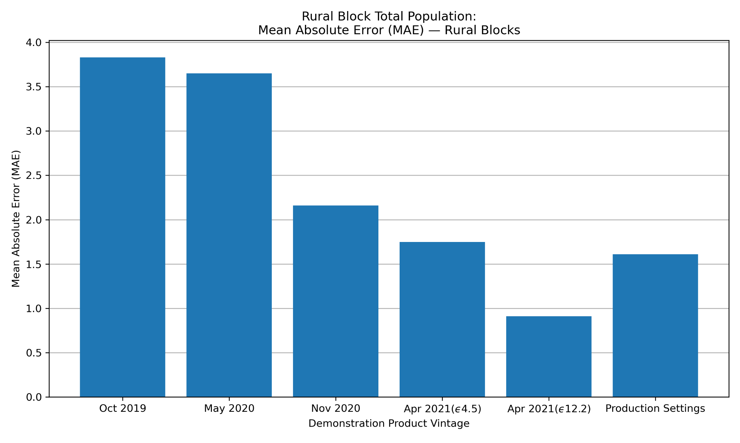
Total Population – Rural Block

Slide 43
Block-Level Inconsistencies
Inconsistency | April 2021 ε12.2 Count of Blocks | Production Settings Count of Blocks
Occupied Housing Units > Household Population | 203,519 | 303,984
Zero Occupied Housing Units; > 0 Household Population | 674,598 | 505,840
Zero Household Population; > 0 Occupied Housing Units | 77,947 | 148,836
Everyone in Block Under 18 | 90,534 | 163,884
> 10 Persons Per Household | 87,342 | 121,376

Slide 44
Privacy protection out of the shadows
Certain privacy practices for previous censuses depended upon obfuscation
2020 DAS demonstration data are the most transparent view into Census Bureau privacy practices ever
We appreciate and are excited to assess feedback from our external partners

Slide 45
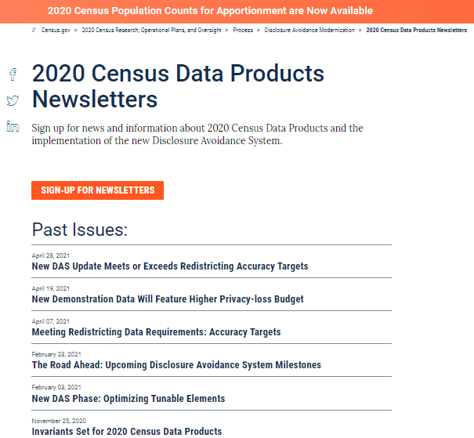
Stay Informed:
Subscribe to the 2020 Census Data Products Newsletters
*Search “Disclosure Avoidance” at www.census.gov

Slide 46
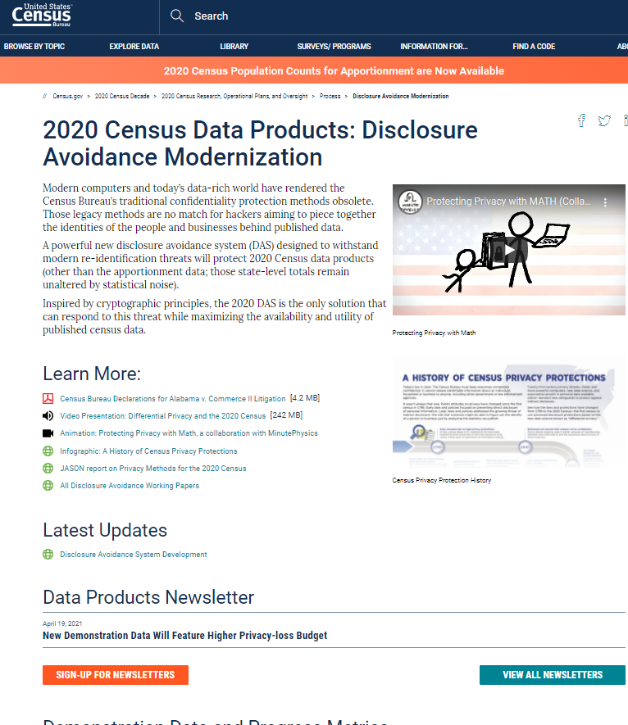

Stay Informed:
Visit Our Website
*Search “Disclosure Avoidance” at www.census.gov

Slide 47

** New Video **
Protecting Privacy in Census Bureau Statistics
*Find it on our website and YouTube Page
Search “Disclosure Avoidance” at www.census.gov

Slide 48
Selected Resources
Technical: https://github.com/uscensusbureau/census2020-das-e2e/blob/master/doc/20190711_0945_Consistency_for_Large_Scale_Differentially_Private_Histograms.pdf
Basics: 2020 Census Data Products: Disclosure Avoidance Modernization
Updates: Developing the DAS: Demonstration Data and Progress Metrics (census.gov)

Slide 49
Thank you.
John.Maron.Abowd@census.gov

